Slide 1
Visualizing and Clustering Climate Change Milestone 2
Lei Zhong
Hantian Zhang
Jian Zhang

Slide 2
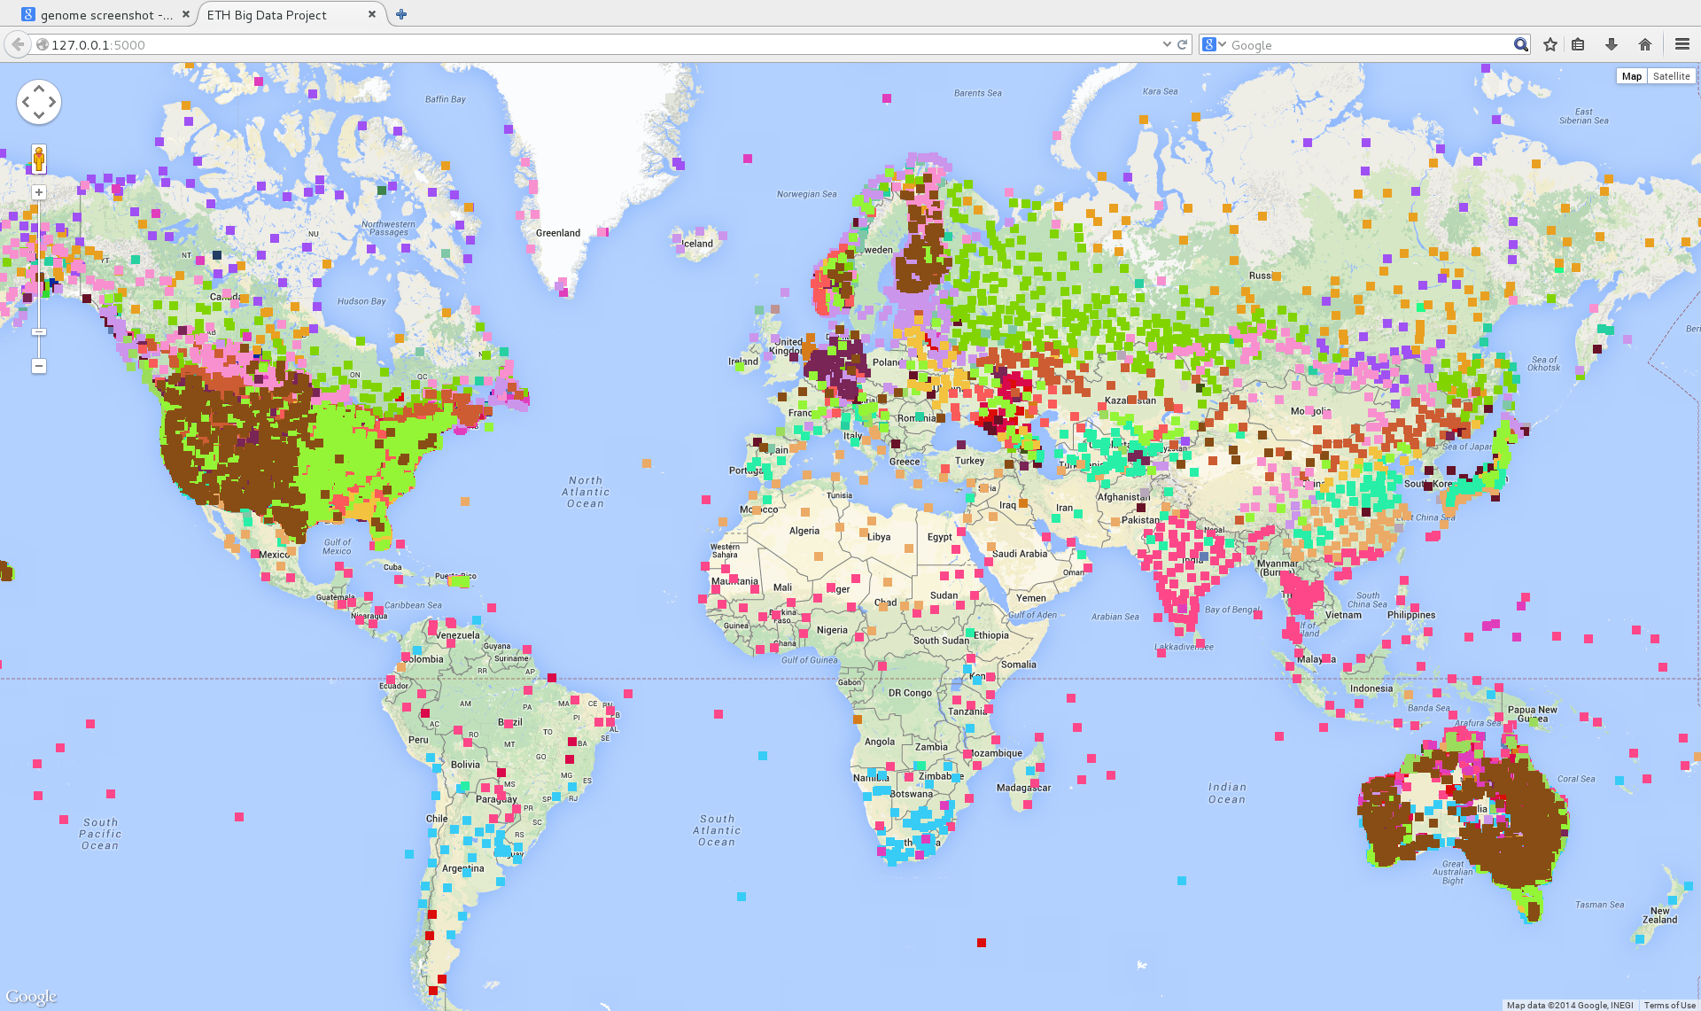
System Overview
Clustering + GoogleMap

Slide 3
Data source
Global Historical Climatology Network (GHCN) by National Climatic Data Centre (NCDC)
daily observations over global land areas
station identifier
date
observation type
observation value
observation time
by-year: from 1763 to 2014
data size: from 3.3k to 164M
We take the whole year data of 2013 for milestone 2

Slide 4
Design
Features:
~37,000 observation stations
5 key elements:
Daily Maximum Temperature
Daily Minimum Temperature
Precipitation
Snowfall
Snow Depth
For each observation station, we use mean and variance value of the 5 key elements in 12 months
120 dimensional

Slide 5
Design
Clustering
K-means method
Different parameters
cluster numbers
PCA for reducing dimensions of features
Use only mean value for the features
Visualization
Use Google Map API
Visualize the clusters on a World Map

Slide 6

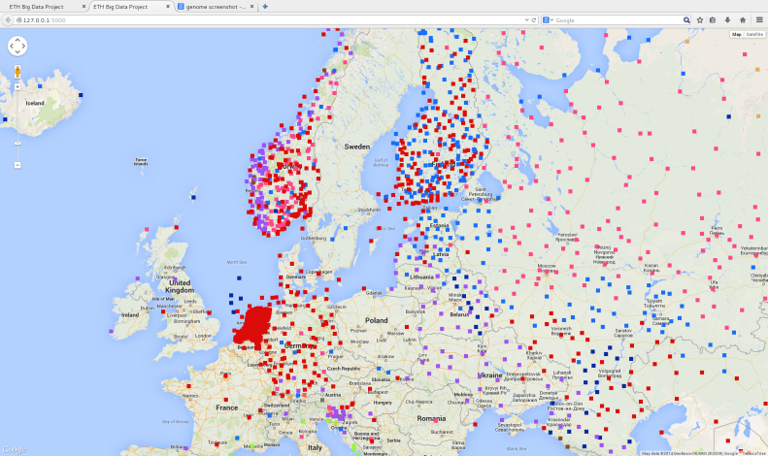
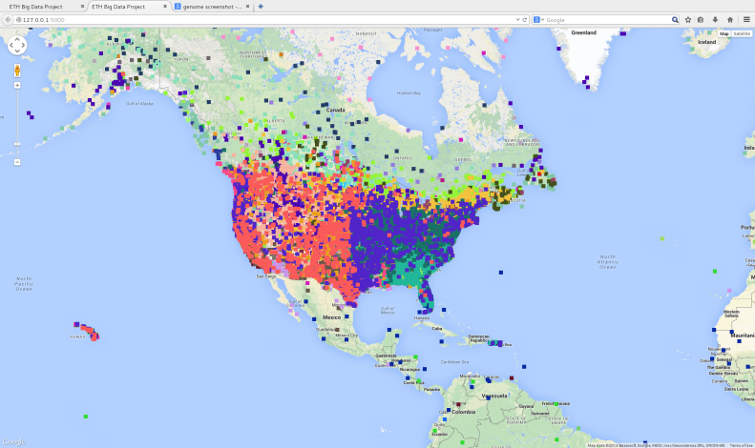
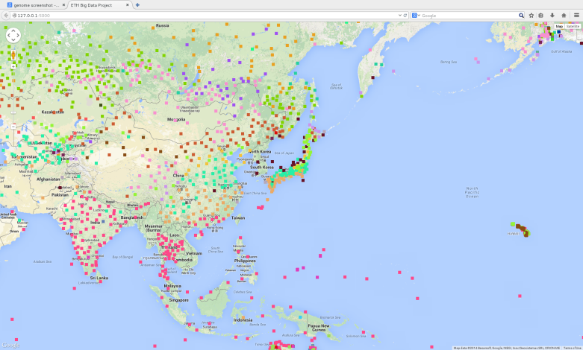
Results
Verification: alignment with prior geology knowledge
Clustering by Latitude, Height above Sea Level, Regional Landform
Well-known Climate Characteristics

Slide 7

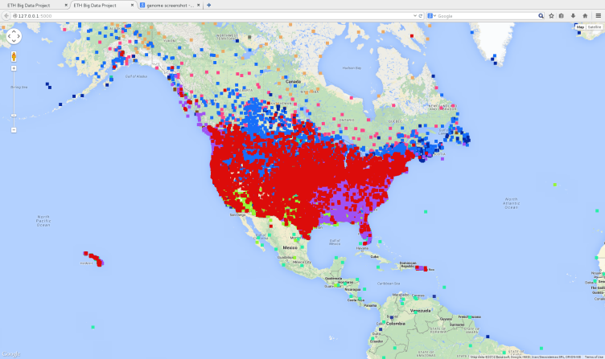
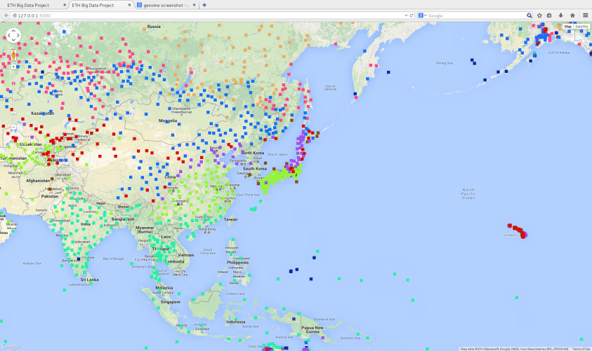

Results
Number of Clusters
Different over different geology characteristics
75 Vs 15 for North America
50 Vs 15 for Asia

Slide 8
Thanks!

